Slide 1
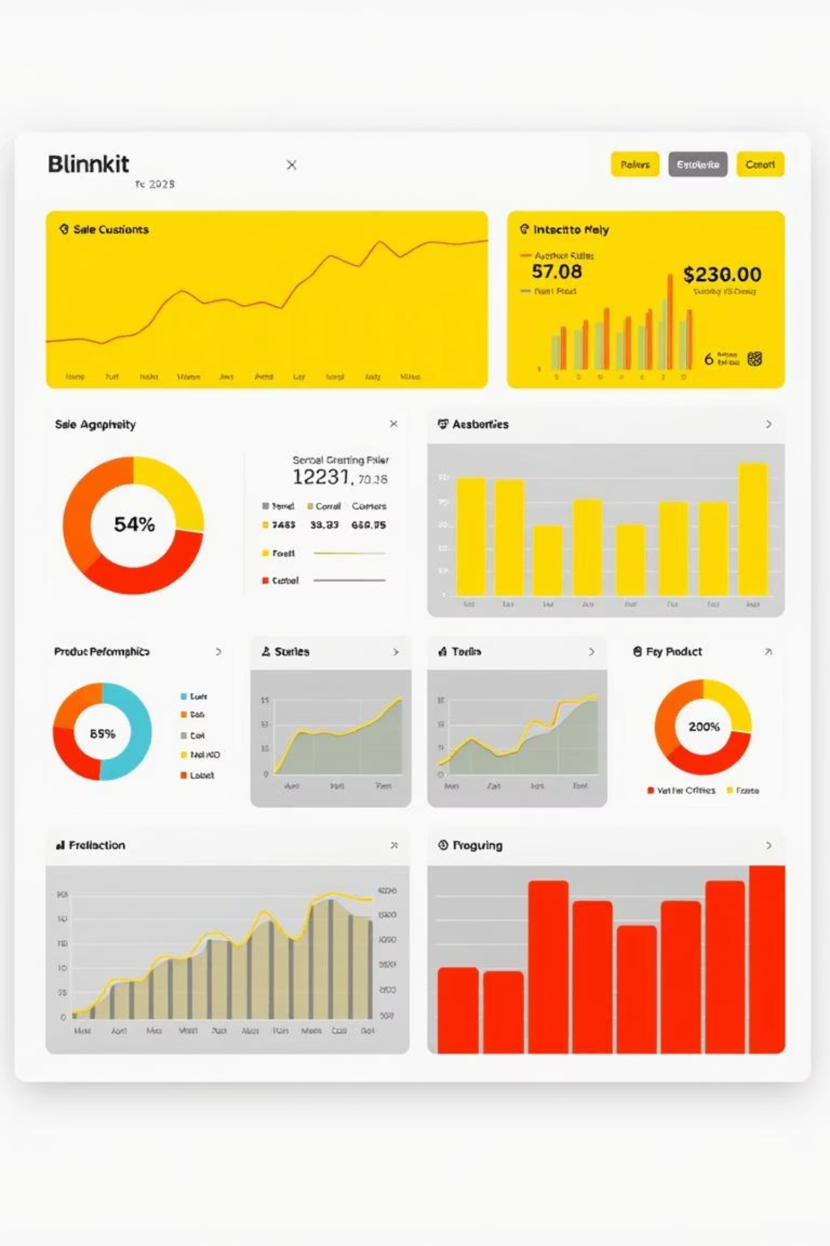
Blinkit Sales Dashboard Analysis
A Comprehensive Report on Sales Performance Across Outlets
Author: Arya Bhor
Tools Used: Power BI, Excel
Date: June 2025

Slide 2

Objective Goal
To analyze Blinkit’s item sales across different outlets to identify trends, patterns, and performance variations based on location, item type, and outlet tiers. This dashboard helps stakeholders:
Understand sales volume and revenue distribution
Compare item performance by category
Discover regional strengths and gaps

Slide 3
Dataset Overview
Your dataset includes a diverse set of attributes:
Item Details: Item Identifier, Item Type, Item Fat Content, Item Weight, Item Visibility
Outlet Details: Outlet Identifier, Outlet Establishment Year, Outlet Location Type, Outlet Size, Outlet Type
Performance Metrics: Sales, Rating
This rich mix allows slicing the data by outlet characteristics and item categories, making the dashboard highly interactive and insightful.

Slide 4
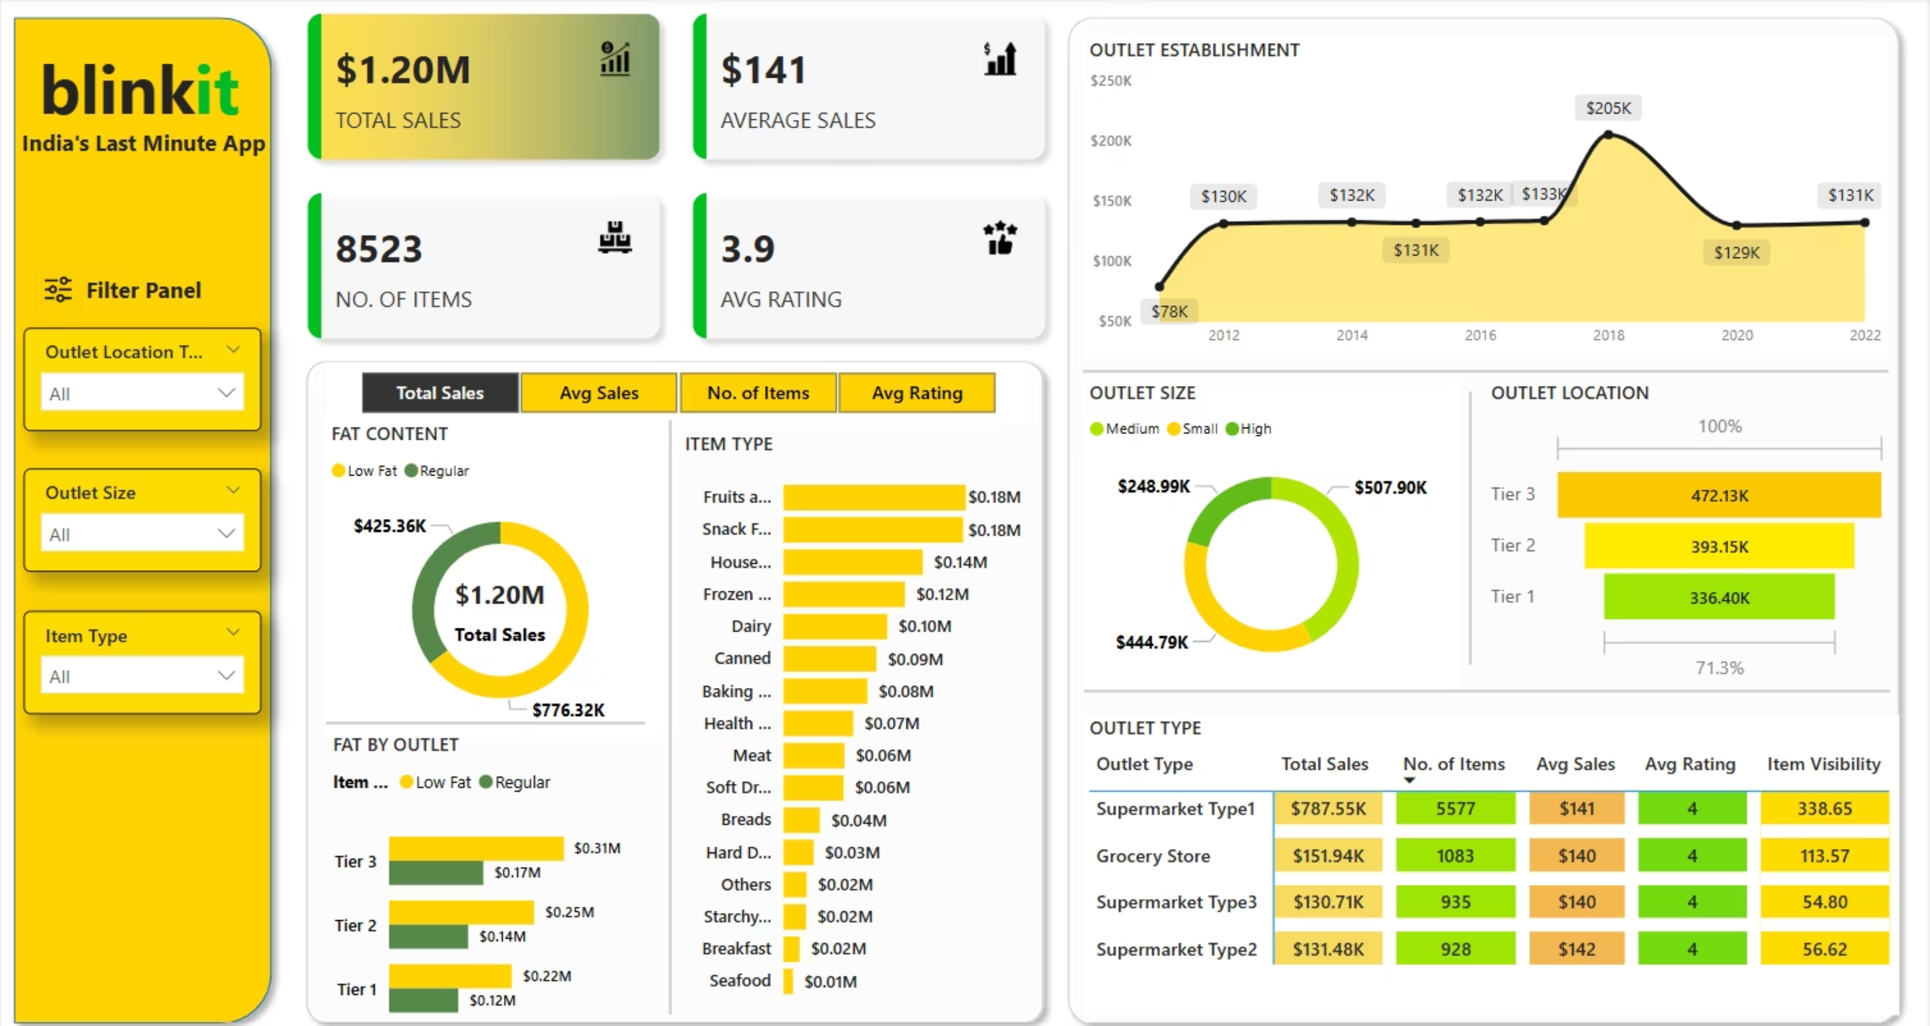
blinkit Sales Dashboard

Slide 5
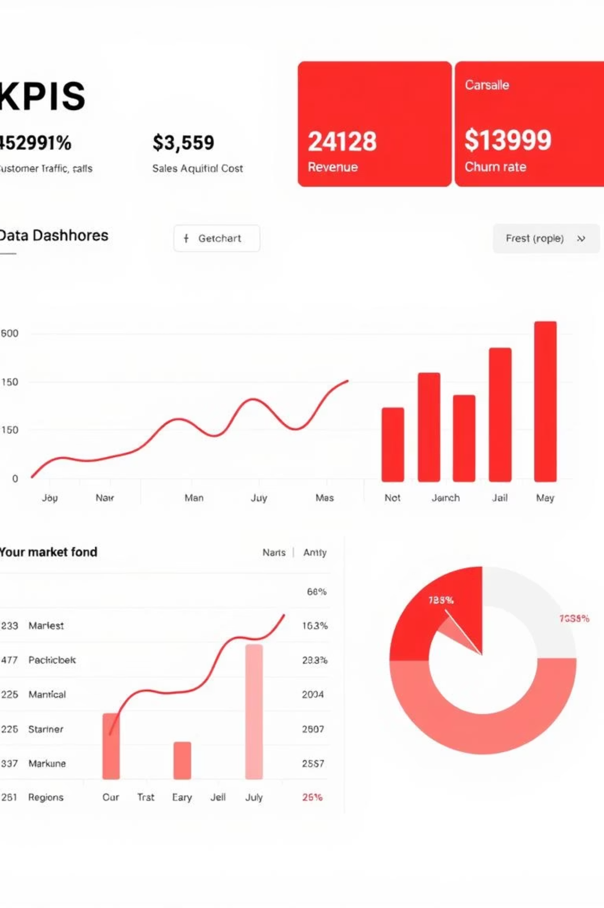
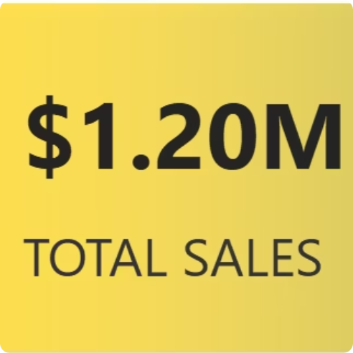
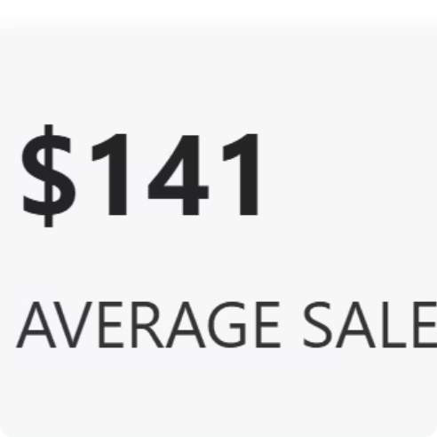
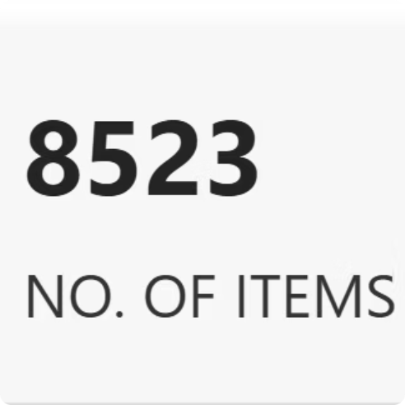
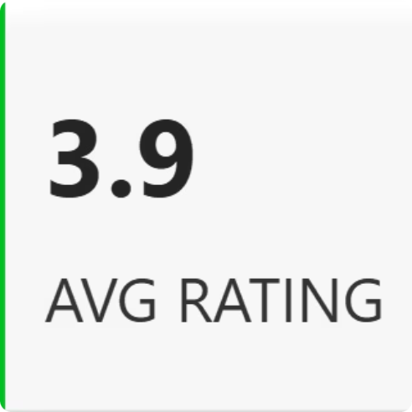
Metrics & KPI Design
You’ve focused on these four primary metrics:
Overall revenue generated across all products/outlets
Sales per product/outlet, helpful for standardization
Total distinct items tracked
User satisfaction insight
KPIs are displayed using dynamic visuals and filters, allowing comparative analysis between outlets, years, and item types.

Slide 6
Visual Insights
Key Insights Observed from Dashboard:
📈 2018 recorded the highest total sales among all years — possibly due to high-performing outlet batches or promotional periods.
🏬 Tier 1 outlets generally outperformed Tier 2 and 3 in total sales.
🍪 Certain item types (e.g., Snacks, Beverages) dominate sales volume, especially in urban areas.
🌆 Outlet Location Type has a clear impact on item demand, with Urban outlets showcasing higher item diversity and revenue.
⭐ Average Rating remains stable across outlets, suggesting consistent customer satisfaction.
(We’ll use your visual charts from the dashboard on this slide.)

Slide 7
Filters & Interactivity
Your dashboard includes powerful filters:
Outlet Location Type: Urban, Semi-Urban, Rural
Outlet Type: Tier 1, Tier 2, Tier 3
Item Type: Categories like Dairy, Beverages, etc.
These filters allow:
Granular comparison of performance
Custom views for internal presentations
Data-driven decisions for specific regions or outlet tiers

Slide 8


Key Takeaways
📌 Year 2018 marked the peak in sales performance
🏙️ Urban/Tier 1 outlets generate the highest revenue
🧃 Beverages and processed foods are top-selling item categories
📊 Consistency in ratings suggests strong customer satisfaction across outlet types

Slide 9





Recommendations
Invest more in expanding high-performing outlet types (Tier 1)
Promote best-selling items in underperforming tiers
Use 2018's patterns as a benchmark for marketing strategies
Consider exploring reasons for lower sales post-2018 (if applicable)

Slide 10

Thank You / Contact
👤 Prepared By: Arya Bhor
📧 Email: aryabhor33@gmail.com
🔗 Portfolio: arya10012 (Arya Mahesh Bhor)

